Slide 1

International Conference on Advanced Systems and Emerging Technologies- ICASET 2025
06th -07th November 2025
Customer Churn Prediction Project
Authors:
Monica Luthra
Sneha Narwal
Diwakar Sherawat
Shruti Gupta
Rony Biju
Abhay Manhas
Affiliation of Presenting Author:
Chandigarh University

Slide 2
International Conference on Advanced Systems and Emerging Technologies- ICASET 2025
06th -07th November 2025
INDEX:
1. Abstract
2. Introduction
3. Literature Review
4. Research Gaps
5. Proposed Methodology
6. Results & Discussion
7. Comparative Analysis
8. Conclusion & Future Work
9. References

Slide 3
International Conference on Advanced Systems and Emerging Technologies- ICASET 2025
06th -07th November 2025
1. ABSTRACT:
One of the biggest problems affecting the telecom industry is the loss of customers in the process commonly referred to as customer churn since saving a customer is cheaper than seeking new one. The paper uses the methods of machine learning to forecast churn with a sample of telecom customers. Models such as the Logistic Regression, Random Forest, and Gradient Boosting were then trained and assessed after preprocessing and exploratory analysis were done. Findings demonstrate that ensemble models performed best in terms of accuracy and recall with the types of contracts, monthly fees, and years of tenure as important churn predictors. These lessons can assist the telecom provider to make specific retention strategies and lessen revenue loss.

Slide 4
International Conference on Advanced Systems and Emerging Technologies- ICASET 2025
06th -07th November 2025
2. INTRODUCTION:
Customer churn, or customer attrition, occurs when users discontinue a company’s services and shift to competitors, leading to significant revenue loss. In the telecom sector, where competition is high, retaining existing customers is far more cost-effective than acquiring new ones. This study aims to develop a machine learning-based predictive framework to identify at-risk customers early and provide actionable insights for retention.
The research employs data preprocessing, exploratory data analysis, feature engineering, and predictive modeling using algorithms such as Logistic Regression, Random Forest, XGBoost, and Neural Networks. By combining predictive analytics with strategic retention recommendations, the proposed model enables telecom operators to proactively reduce churn and enhance long-term customer loyalty.

Slide 5
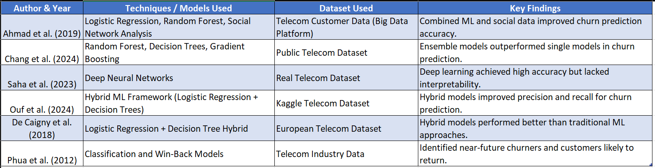
International Conference on Advanced Systems and Emerging Technologies- ICASET 2025
06th -07th November 2025
4. LITERATURE REVIEW :

Slide 6
International Conference on Advanced Systems and Emerging Technologies- ICASET 2025
06th -07th November 2025
5. RESEARCH GAPS :
Most systems predict churn but do not recommend retention actions.
Imbalanced datasets reduce classifier accuracy.
Black-box models hinder managerial interpretation.
Lack of real-time, automated decision frameworks for telecom.
Limited adaptability across telecom markets.

Slide 7
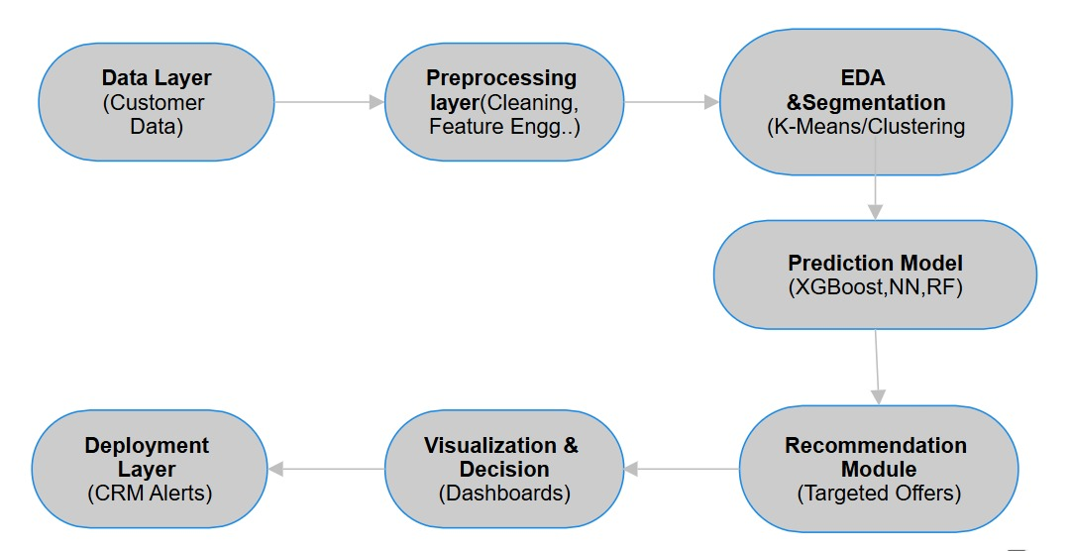
International Conference on Advanced Systems and Emerging Technologies- ICASET 2025
06th -07th November 2025
6. PROPOSED METHODOLOGY :

Slide 8
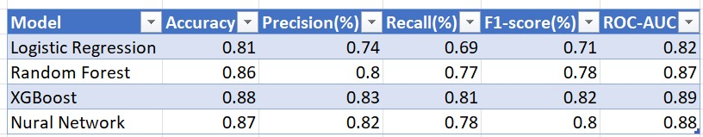
International Conference on Advanced Systems and Emerging Technologies- ICASET 2025
06th -07th November 2025
7. RESULTS & DISCUSSION:
Findings:
XGBoost outperformed all models in predictive accuracy and generalization.
Key churn factors: short tenure, month-to-month contracts, and electronic payments.
Results support segmented retention strategies like loyalty rewards and personalized offers.

Slide 9
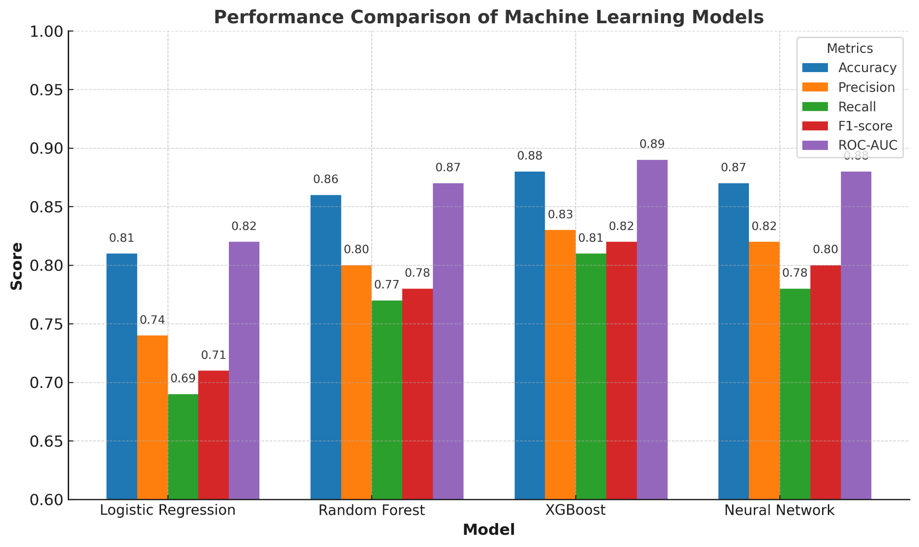
International Conference on Advanced Systems and Emerging Technologies- ICASET 2025
06th -07th November 2025
8. COMPARATIVE ANALYSIS:

Slide 10
International Conference on Advanced Systems and Emerging Technologies- ICASET 2025
06th -07th November 2025
9. CONCLUSION & FUTURE WORK :
Conclusion:
The proposed churn prediction and retention framework effectively identifies at-risk customers using machine learning, with XGBoost delivering the best performance.
It bridges prediction and action through a hybrid predictive–prescriptive approach, improving retention and profitability.
Future Work:
Extend to deep learning and real-time deployment.
Add explainable AI for better interpretability.
Expand to multi-service providers like OTT and broadband.

Slide 11
International Conference on Advanced Systems and Emerging Technologies- ICASET 2025
06th -07th November 2025
10. REFERENCES :
[1] A. K. Ahmad, A. Jafar, and K. Aljoumaa, “Customer churn prediction in telecom using machine learning and social network analysis in big data platform,” J Big Data, vol. 6, no. 1, Apr. 2019, doi: 10.1186/s40537-019-0191-6.
[2] J. B. Heide and K. H. Wathne, “Friends, Businesspeople, and Relationship Roles: A Conceptual Framework and a Research Agenda,” J Mark, vol. 70, no. 3, pp. 90–103, Jul. 2006, doi: 10.1509/JMKG.70.3.090.
[3] J. A. Barrios, M. Torres-Alvarado, and A. Cavazos, “Neural, fuzzy and Grey-Box modelling for entry temperature prediction in a hot strip mill,” Expert Syst Appl, vol. 39, no. 3, pp. 3374–3384, Feb. 2012, doi: 10.1016/J.ESWA.2011.09.025.
[4] C. Phua, H. Cao, J. B. Gomes, and M. N. Nguyen, “Predicting Near-Future Churners and Win-Backs in the Telecommunications Industry,” Oct. 2012, Accessed: Sep. 09, 2025. [Online]. Available: https://arxiv.org/pdf/1210.6891
[5] L. Saha, H. K. Tripathy, T. Gaber, H. El-Gohary, and E. S. M. El-kenawy, “Deep Churn Prediction Method for Telecommunication Industry,” Sustainability 2023, Vol. 15, Page 4543, vol. 15, no. 5, p. 4543, Mar. 2023, doi: 10.3390/SU15054543.
[6] V. Chang, K. Hall, Q. A. Xu, F. O. Amao, M. A. Ganatra, and V. Benson, “Prediction of Customer Churn Behavior in the Telecommunication Industry Using Machine Learning Models,” Algorithms 2024, Vol. 17, Page 231, vol. 17, no. 6, p. 231, May 2024, doi: 10.3390/A17060231.
[7] M. V. Sokolova and A. Fernández-Caballero, “Evaluation of environmental impact upon human health with DeciMaS framework,” Expert Syst Appl, vol. 39, no. 3, pp. 3469–3483, Feb. 2012, doi: 10.1016/J.ESWA.2011.09.037.

Slide 12
International Conference on Advanced Systems and Emerging Technologies- ICASET 2025
06th -07th November 2025
[8] A. De Caigny, K. Coussement, and K. W. De Bock, “A new hybrid classification algorithm for customer churn prediction based on logistic regression and decision trees,” Eur J Oper Res, vol. 269(2), no. 2, pp. 760–772, Sep. 2018, doi: 10.1016/j.ejor.2018.02.009.
[9] D. Van den Poel and B. Larivière, “Customer Attrition Analysis For Financial Services Using Proportional Hazard Models,” Eur J Oper Res, vol. 157, no. 1, pp. 196–217, Aug. 2004, doi: 10.1016/s0377-2217(03)00069-9.
[10] A. K. Ahmad, A. Jafar, and K. Aljoumaa, “Customer churn prediction in telecom using machine learning in big data platform,” J Big Data, vol. 6, no. 1, pp. 1–24, Dec. 2019, doi: 10.1186/S40537-019-0191-6/TABLES/4.
[11] V. Chang, K. Hall, Q. A. Xu, F. O. Amao, M. A. Ganatra, and V. Benson, “Prediction of Customer Churn Behavior in the Telecommunication Industry Using Machine Learning Models,” Algorithms 2024, Vol. 17, Page 231, vol. 17, no. 6, p. 231, May 2024, doi: 10.3390/A17060231.
[12] K. Tabianan, S. Velu, and V. Ravi, “K-Means Clustering Approach for Intelligent Customer Segmentation Using Customer Purchase Behavior Data,” Sustainability 2022, Vol. 14, Page 7243, vol. 14, no. 12, p. 7243, Jun. 2022, doi: 10.3390/SU14127243.
[13] M. T. Ribeiro, S. Singh, and C. Guestrin, “‘Why Should I Trust You?’: Explaining the Predictions of Any Classifier,” NAACL-HLT 2016 - 2016 Conference of the North American Chapter of the Association for Computational Linguistics: Human Language Technologies, Proceedings of the Demonstrations Session, pp. 97–101, Feb. 2016, doi: 10.18653/v1/n16-3020.
[14] S. M. Lundberg, P. G. Allen, and S.-I. Lee, “A Unified Approach to Interpreting Model Predictions”, Accessed: Sep. 09, 2025. [Online]. Available: https://github.com/slundberg/shap
[15] S. Ouf, K. T. Mahmoud, and M. A. Abdel-Fattah, “A proposed hybrid framework to improve the accuracy of customer churn prediction in telecom industry,” J Big Data, vol. 11, no. 1, pp. 1–27, Dec. 2024, doi: 10.1186/S40537-024-00922-9/TABLES/9.
[16] V. Chang, K. Hall, Q. A. Xu, F. O. Amao, M. A. Ganatra, and V. Benson, “Prediction of Customer Churn Behavior in the Telecommunication Industry Using Machine Learning Models,” Algorithms 2024, Vol. 17, Page 231, vol. 17, no. 6, p. 231, May 2024, doi: 10.3390/A17060231.

Slide 13
International Conference on Advanced Systems and Emerging Technologies- ICASET 2025
06th -07th November 2025
[17] V. Chang, K. Hall, Q. A. Xu, F. O. Amao, M. A. Ganatra, and V. Benson, “Prediction of Customer Churn Behavior in the Telecommunication Industry Using Machine Learning Models,” Algorithms 2024, Vol. 17, Page 231, vol. 17, no. 6, p. 231, May 2024, doi: 10.3390/A17060231.
[18] S. Ouf, K. T. Mahmoud, and M. A. Abdel-Fattah, “A proposed hybrid framework to improve the accuracy of customer churn prediction in telecom industry,” J Big Data, vol. 11, no. 1, pp. 1–27, Dec. 2024, doi: 10.1186/S40537-024-00922-9/TABLES/9.
[19] A. K. Ahmad, A. Jafar, and K. Aljoumaa, “Customer churn prediction in telecom using machine learning in big data platform,” J Big Data, vol. 6, no. 1, pp. 1–24, Dec. 2019, doi: 10.1186/S40537-019-0191-6/TABLES/4.
[20] N. V. Chawla, K. W. Bowyer, L. O. Hall, and W. P. Kegelmeyer, “SMOTE: Synthetic Minority Over-sampling Technique,” Journal of Artificial Intelligence Research, vol. 16, pp. 321–357, Jun. 2002, doi: 10.1613/JAIR.953.
[21] T. Xu, Y. Ma, C. Ao, M. Qu, and X. Meng, “A Novel Telecom Customer Churn Analysis System Based on RFM Model and Feature Importance Ranking”, doi: 10.28945/5192.
[22] L. Breiman, “Random forests,” Mach Learn, vol. 45, no. 1, pp. 5–32, Oct. 2001, doi: 10.1023/A:1010933404324/METRICS.
[23] T. Chen and C. Guestrin, “XGBoost: A scalable tree boosting system,” Proceedings of the ACM SIGKDD International Conference on Knowledge Discovery and Data Mining, vol. 13-17-August-2016, pp. 785–794, Aug. 2016, doi: 10.1145/2939672.2939785/SUPPL_FILE/KDD2016_CHEN_BOOSTING_SYSTEM_01-ACM.MP4.
[24] Y. Lecun, Y. Bengio, and G. Hinton, “Deep learning,” Nature, vol. 521, no. 7553, pp. 436–444, May 2015, doi: 10.1038/NATURE14539;SUBJMETA=117,639,705;KWRD=COMPUTER+SCIENCE,MATHEMATICS+AND+COMPUTING.
[25] T. Fawcett, “An introduction to ROC analysis,” Pattern Recognit Lett, vol. 27, no. 8, pp. 861–874, Jun. 2006, doi: 10.1016/J.PATREC.2005.10.010.

